Slide 1
DSO 597 Consulting Project
Site Selection
_________________________________
Group 3
Sarat Chandra, Meiwei He, Xi Liu, Mingyu Lu
Min Wu, Kehan Yu, Shauna Zhou

Slide 2

Agenda
Objective
Approach to Business Problem
Data Processing
Visualization and findings
Modeling & Site Selection

Slide 3

Objective
1
2
3
Identify the most important characteristics a retailer looks for when determining potential locations for a new store.
Develop creative methods to measure and track those characteristics.
Model and test how important each characteristic is to the retailer.
Identify prime future locations for different retailers.

Slide 4



Approach to Business Problem
T.J. Maxx - targets middle to upper-middle class income female shoppers with families.
Marshall - a sister stores as T.J. Maxx, shares a similar footprint throughout the country
HomeGoods - sells distinctive home fashions at irresistible prices to middle class and upper middle class families.
Notes:
It sells men's, women's and children's apparel and shoes, toys, bath and beauty, accessories, and home products ranging from furniture to kitchen utensils

Slide 5
Data Processing
1
Data Collection
2
Data preparation
3
Identify Variable
Notes:
WM and LMY

Slide 6
Data Collection
Data Source
Individual Income Tax Statistics - ZIP Code Data (SOI)
https://www.irs.gov/statistics/soi-tax-stats-individual-income-tax-statistics-zip-code-data-soi
Store visit data
Placer.ai
Family number
Census

Slide 7
Data preparation
Data discovery and profiling
Data cleaning
Data transformation
Explore the collected datasets for potential connections between variables and stores.
Remove:
Population = 0
Income tax = 0
Family number = 0
For stores with more than one Lowe’s store nearby, we use the average of Lowe’s visits.
Density
Population as the common factor affecting all variables
Increases reliability of current variables in their geographical locations
Zip code
Trade area

Slide 8
Identified Variables
Visits Density | Visit volume per person in particular trade area
Individual Income Tax Density | Individual Income Tax per person in particular trade area
Family Density | The probability that a person does not live alone in the trade area
Competitor Visit Density (Bed Bath & Beyond, Lowe’s, etc.) | Visit densities of Bed Bath & Beyond, Lowe’s, etc.

Slide 9
Visualizations
Notes:
WM and LMY

Slide 10
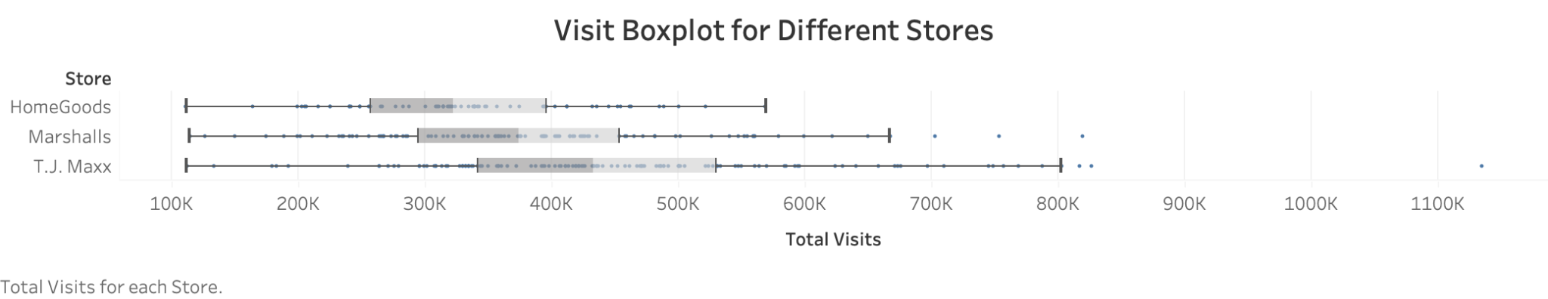
Visit Difference Among Stores
25%
50%
75%
There exists significant differences between 3 store visits, suggesting that we should consider store type when predicting visits.
Notes:
Now let's take a look at the total visits of the three stores. Here is media. 25% to 75% of stores have total visits in this range. From this, we can know that the total visits of the three stores are very different. In other words, homegoods has the least total visits, while tj maxx is the largest.

Slide 11

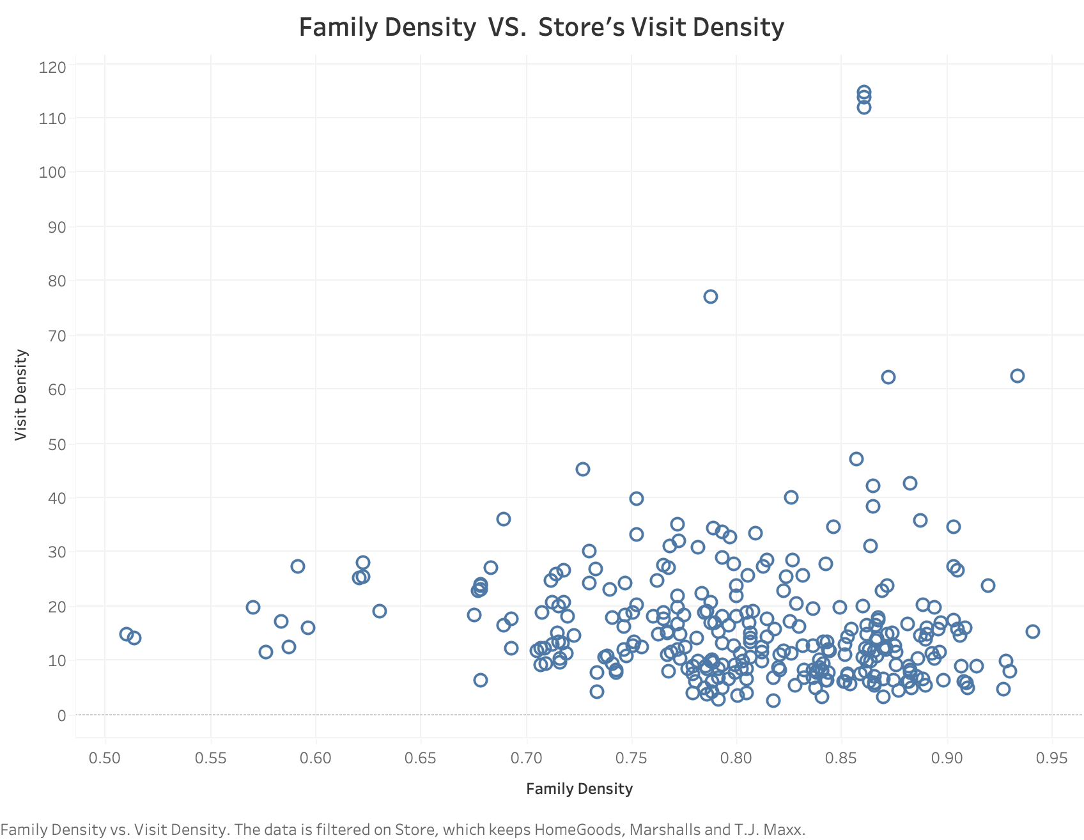
Family Density and Visit Density
Family Density=
the probability that a person does not live alone
Interesting Findings:
There is a clustering in Family Density between 0.67 and 0.93, which indicates that retailers chose high family density areas for existing store locations.
Family density in US:0.25 (2021)
Reason: families are target customers for those retailing stores.

Slide 12
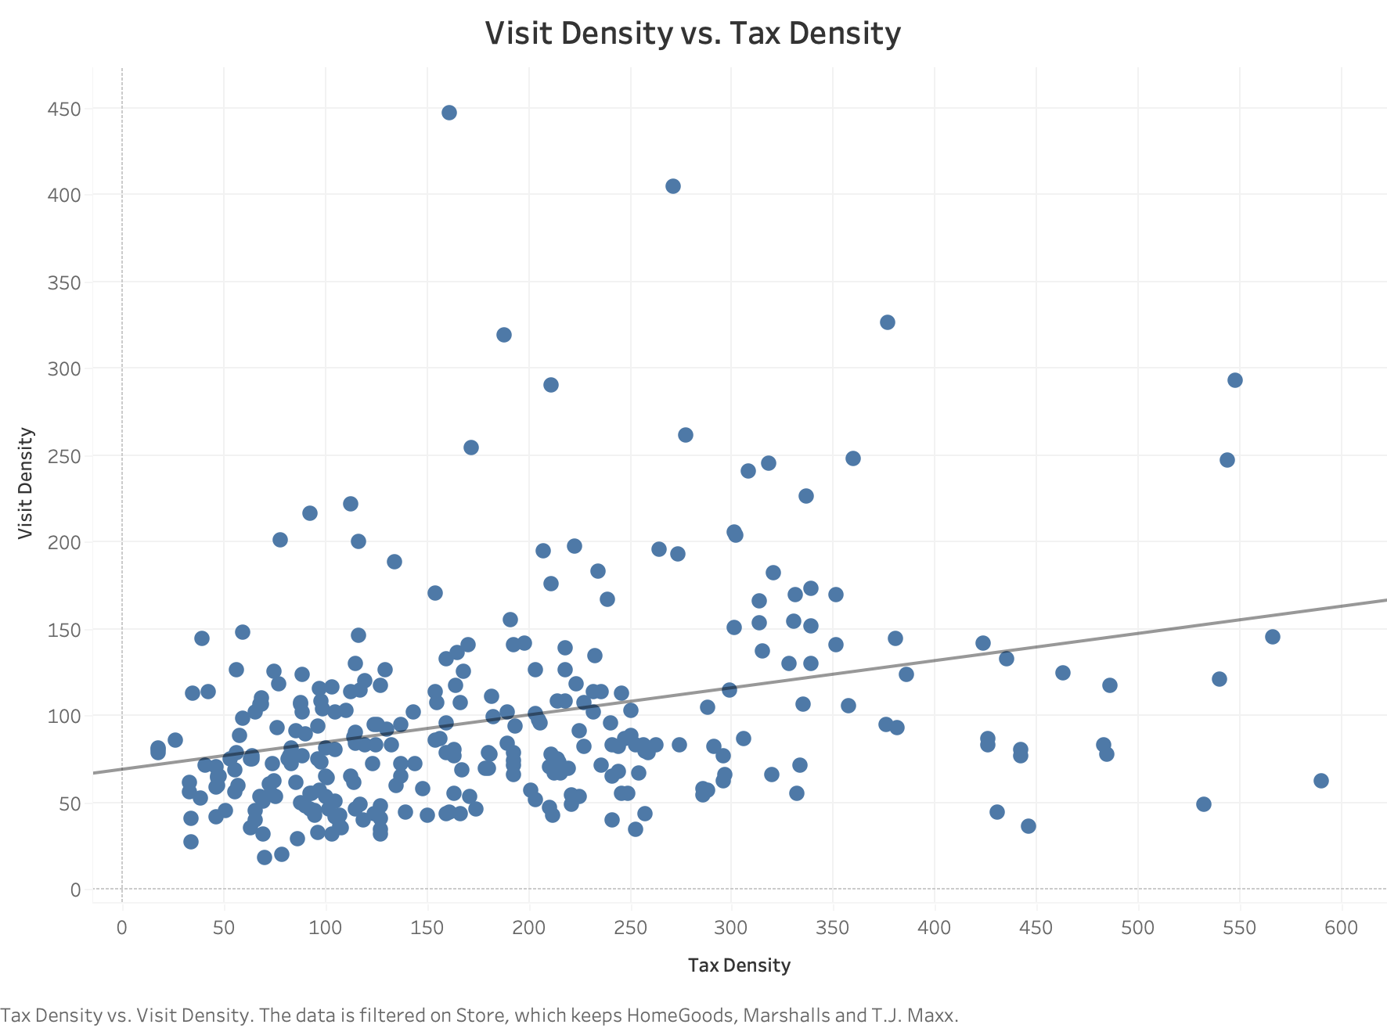
Income Tax Density and Visit Density
Visit Density=0.16*Tax Density+69.09
R-Squared: 0.096
P-Value:<0.0001
Interesting Findings:
There is a positive relationship between Tax Density and Visits Density.
Reason: More tax means more income which should lead to more consumption.

Slide 13
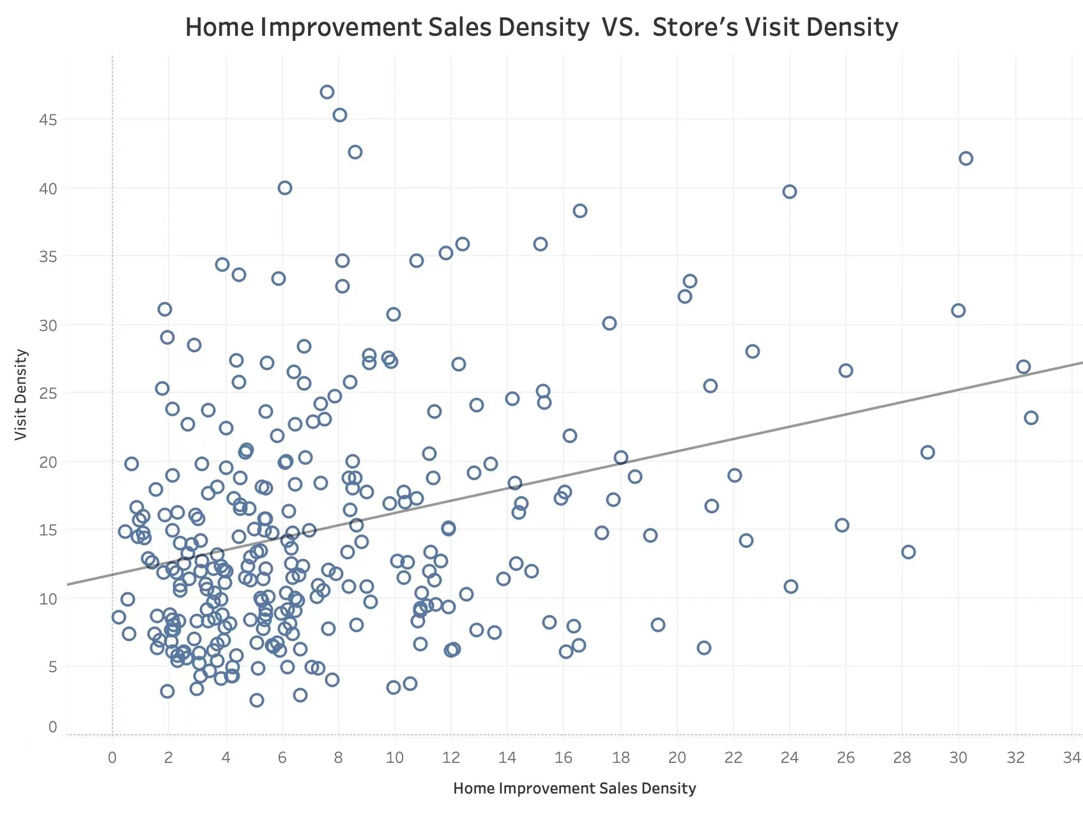
Home Improvement Sales Density and Visits Density
Visit Density = 0.450506*Home Improvement Sales Density + 11.6916
R-Squared: 0.103562
P-Value: < 0.0001
Feature Explanation:
Home Improvement Sales Density:
$k spent on home improvements per person
Interesting Findings:
Positive Relationship
Reason: T.J.Maxx, Marshalls and HomeGoods all sell home improvements products. Therefore, if local residents have the habit of spending more on home improvements, they will visit the three stores more frequently.

Slide 14
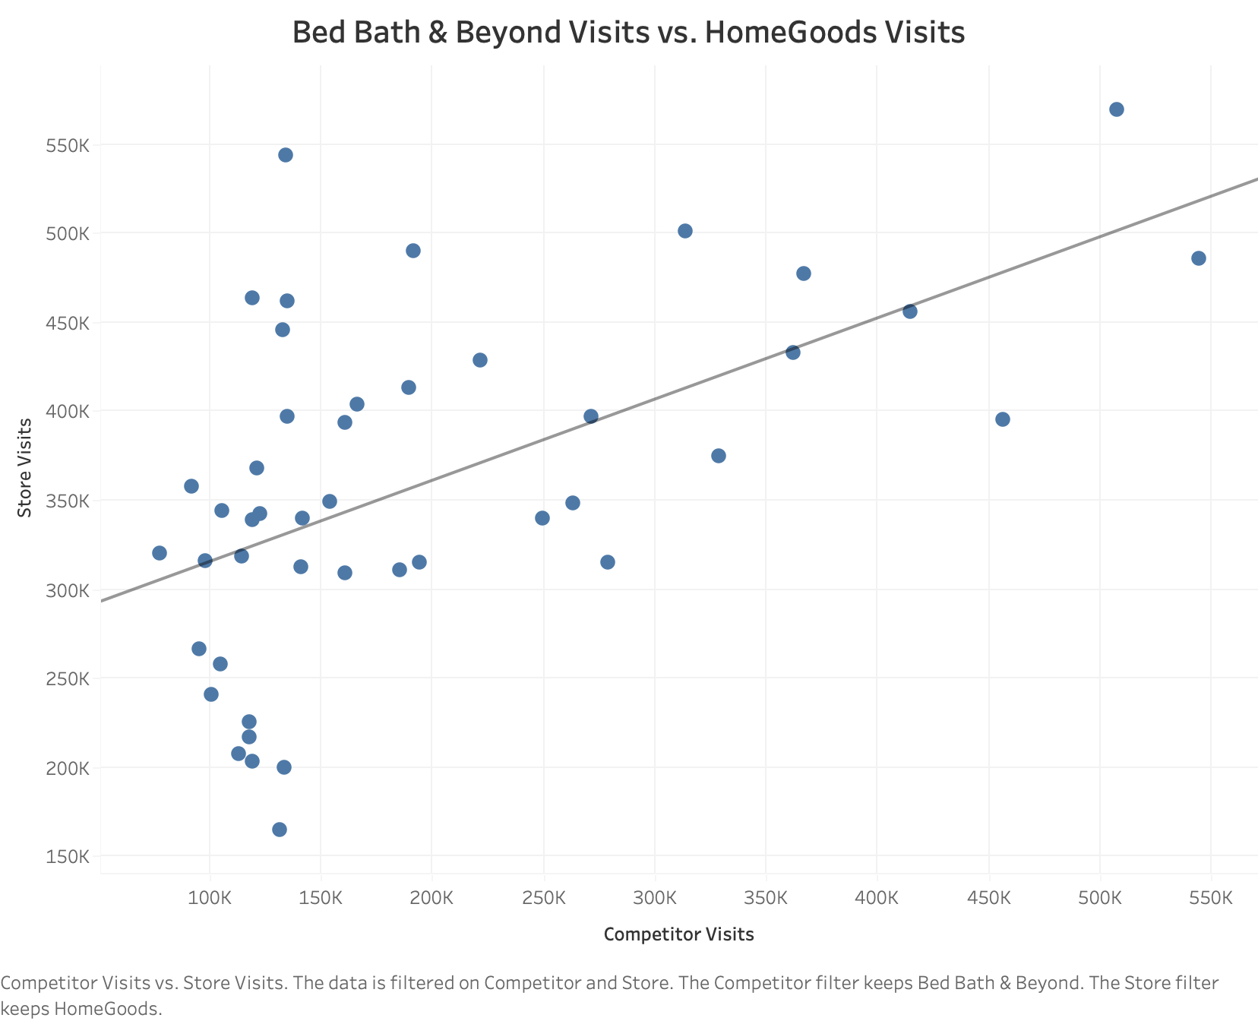
Competitor Visits and Store Visits
HomeGoods Visits=0.46*BBB Visits+269689
R-Squared:0.31
P-Value:<0.0001
Interesting Findings:
The positive relationship indicates there exists co-tenancy between Bed Bath & Beyond and HomeGoods.
Possible reason: Customers tend to shop at clustered furniture stores together.

Slide 15
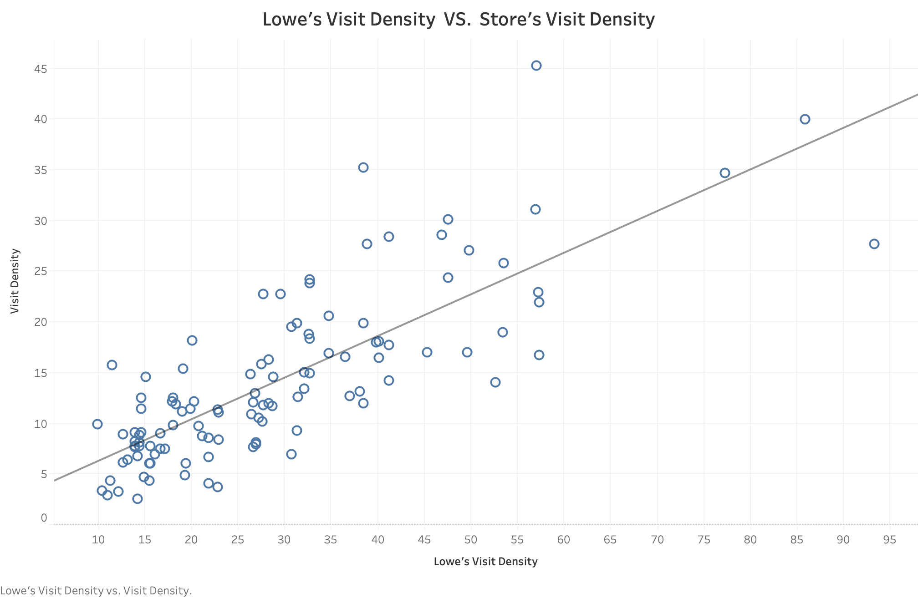
Competitor Visit Density and Store Visit Density
Visit Density = 0.410785*Lowe's Visit Density + 2.13152
R-Squared: 0.623454
P-Value: < 0.0001
Interesting Findings:
The positive relationship indicates that there exists co-tenancy between Lowe’s and our target stores.
Reason: Lowe’s is often located in remote area and accessed by long-time driving. Customers tend to visit stores nearby considering high time cost.

Slide 16
Modeling &
Site Selection

Slide 17
Modeling: Random Forest Regressor
Input Variables
Income density
Store type
Family density
Lowe’s visit density
Target Variable
Visit density
R²: 52.3%
MAE: 3.65
Mean visit density: 16.75
Mean absolute error is the absolute error between prediction and actual value.

Slide 18
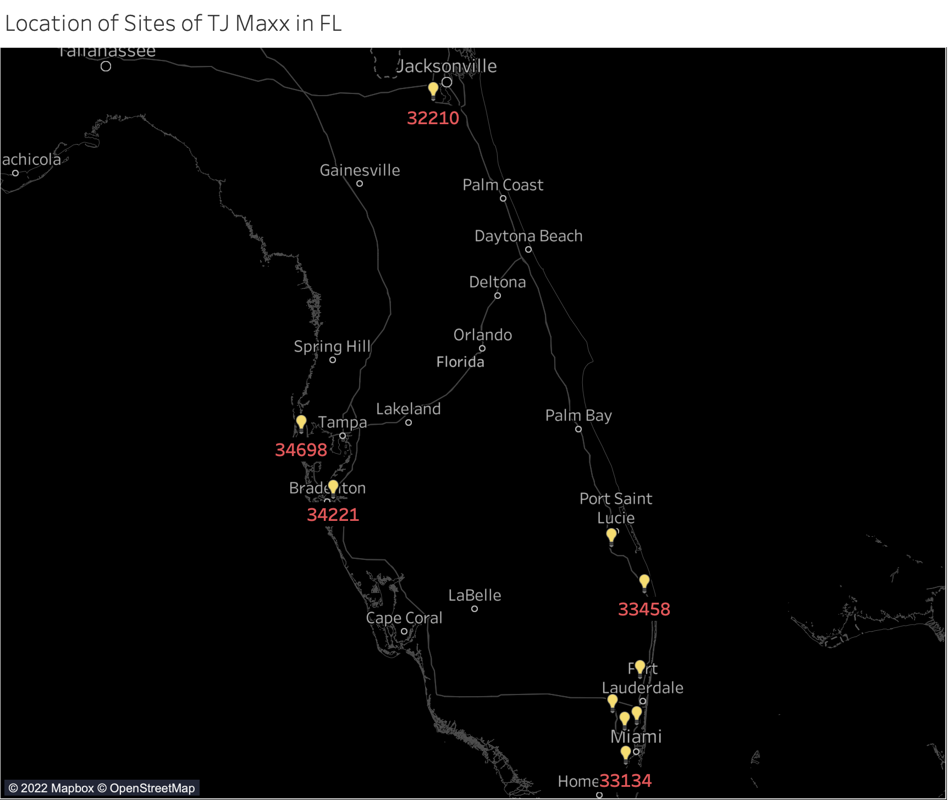
TJMAXX in FL:
33433
34953
33458
33025
33021
34698
33326
32210
33134
34221

Slide 19
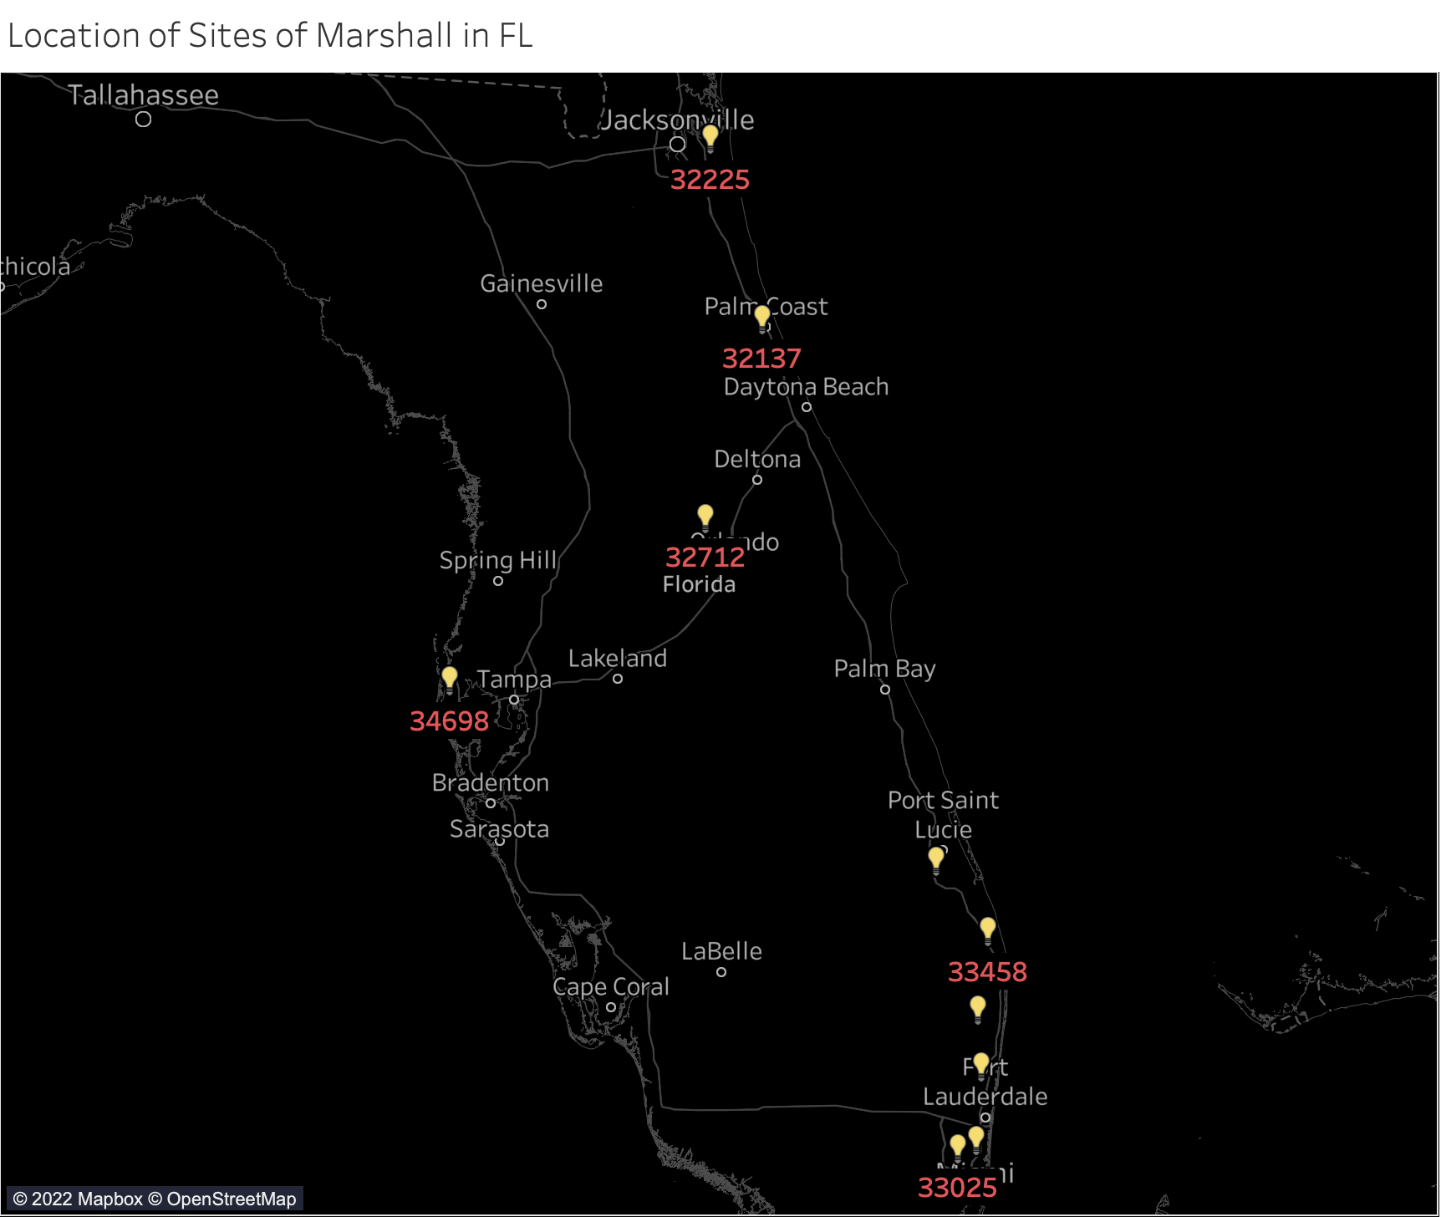
Marshalls in FL:
33433
33021
32225
34953
33467
34698
33458
32712
33025
32137

Slide 20
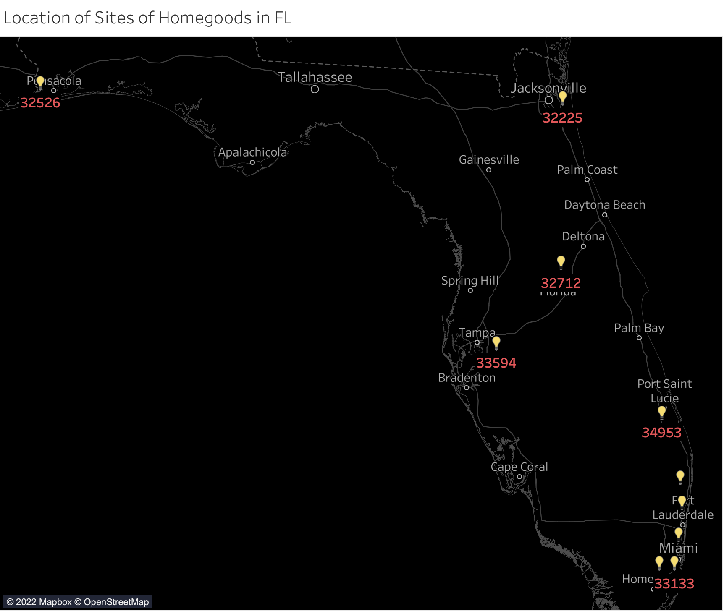
Homegoods in FL:
33433
34953
32225
33021
33175
33467
32712
32526
33594
33133

Slide 21
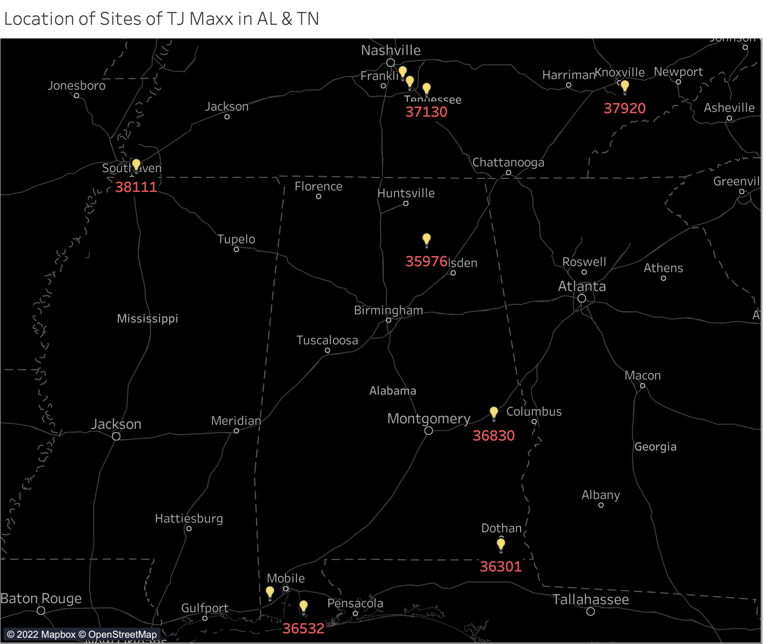
TJMAXX in AL:
37167
37013
38111
36695
36301
36830
TJMAXX in TN:
37167
37013
38111
37920
37130

Slide 22
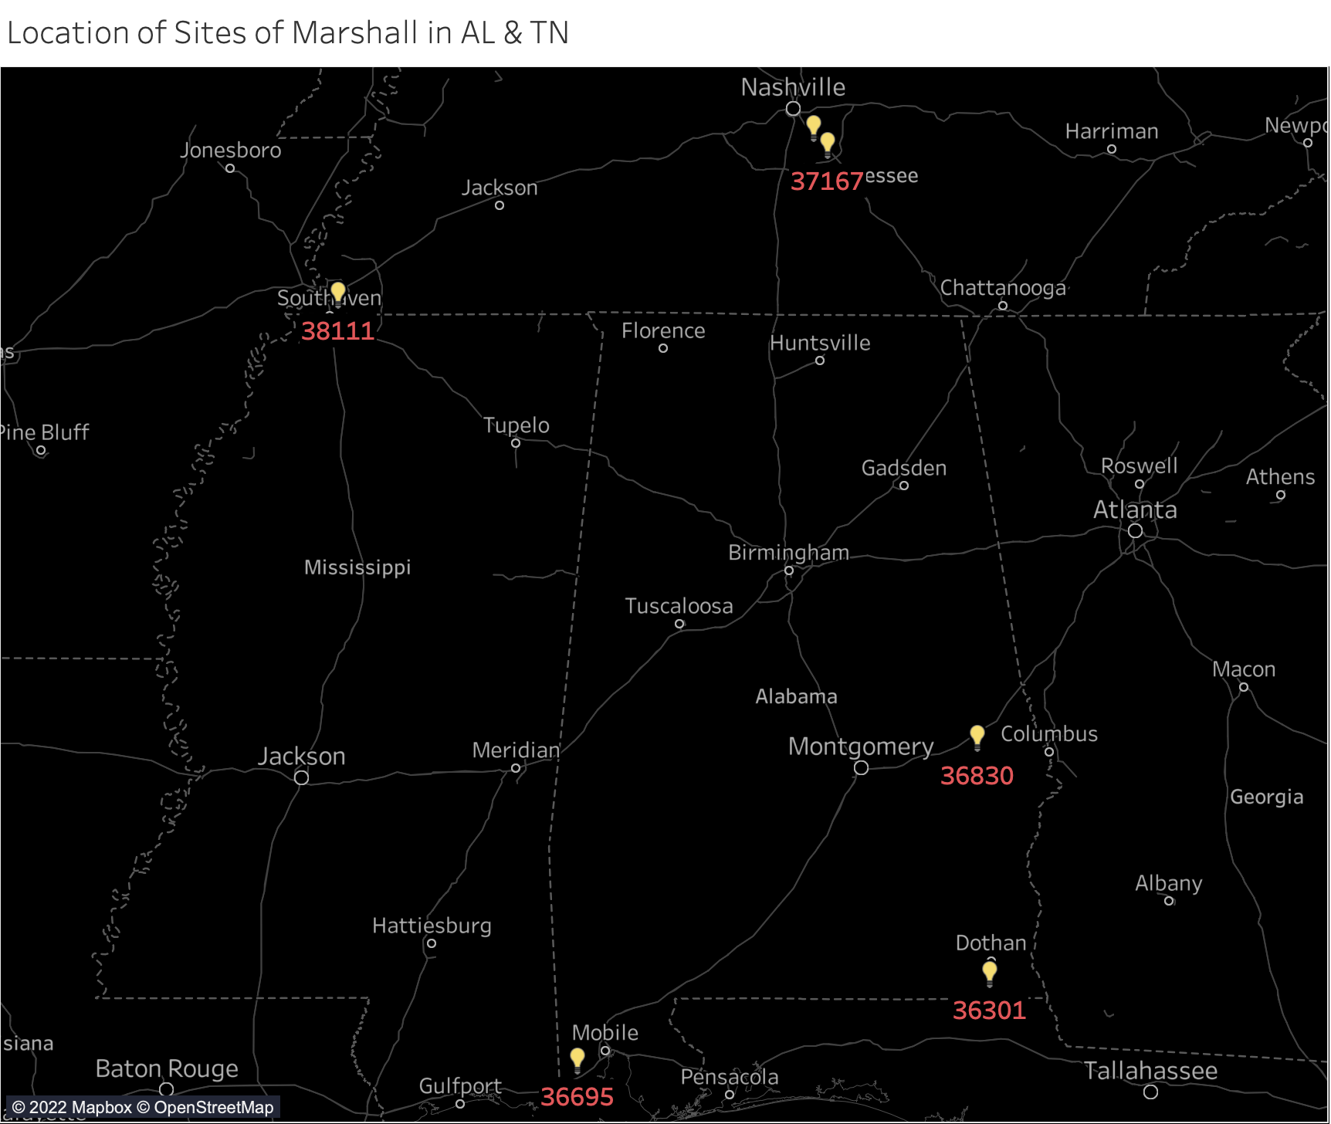
Marshalls in AL:
36695
36301
36830
Marshalls in TN:
37167
37013
38111

Slide 23
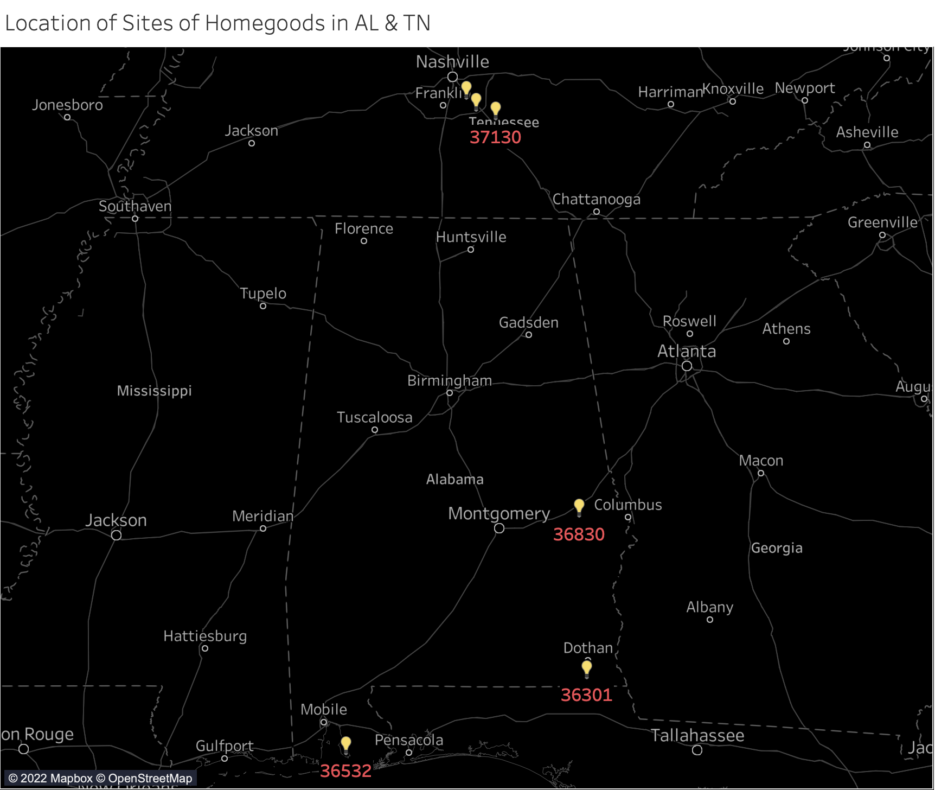
Homegoods in AL:
36301
36830
36532
Homegoods in TN:
37167
37013
37130

Slide 24
Thank you!
Questions?

